Slide 1

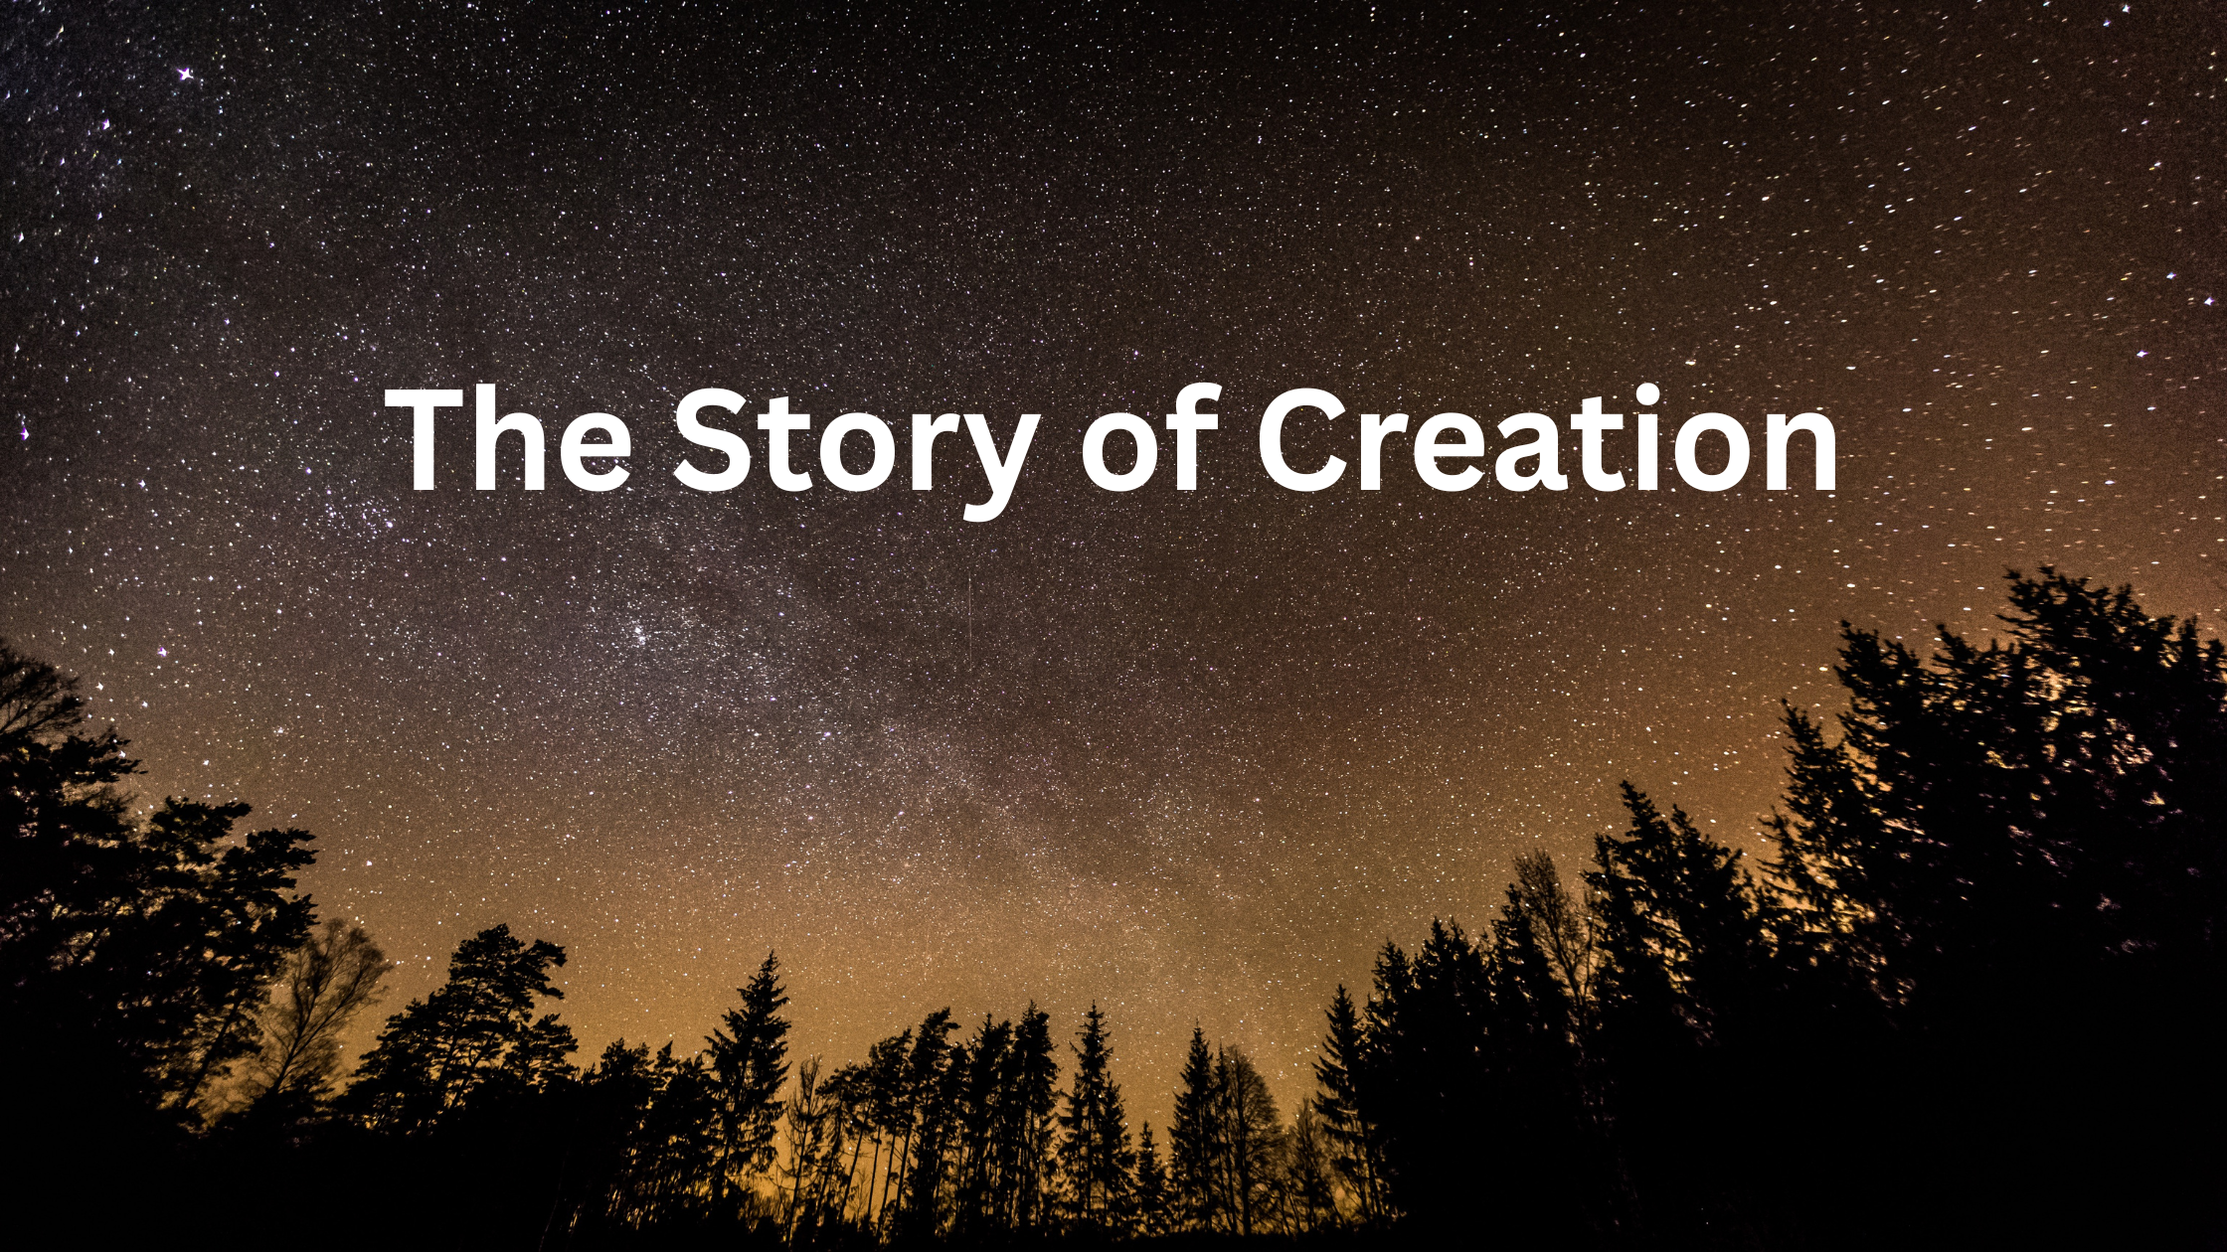
The Story of Creation
Children (Ages 4 -12)
Dr. William A King Jr

Slide 2
Slide 2
Sample

